Slide 1
Week 9
Alexey V. Zimin
JHU BME 580.417/707

Slide 2
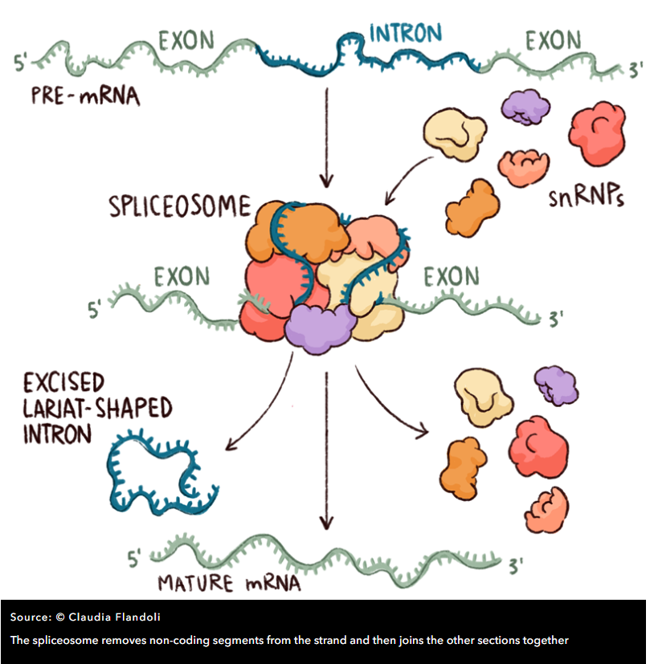
Splicing
Spliceosome includes five so-called ‘small nuclear ribonucleoproteins’ (snRNPs, often pronounced ‘snurps’) and numerous associated proteins.
The snRNPs contain RNA that is rich in Uracil, the RNA base that replaces DNA’s Thymine, and they are named – perhaps unimaginatively – U1, U2, U4, U5 and U6
Spliceosome determines the start and end of an intron by detecting DNA patterns around donor (typically GT) and acceptor (typically AG) sites

Slide 3
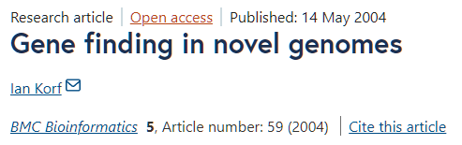
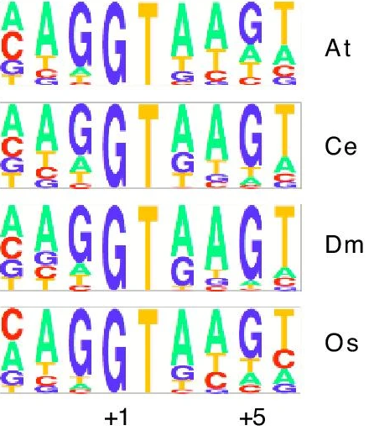
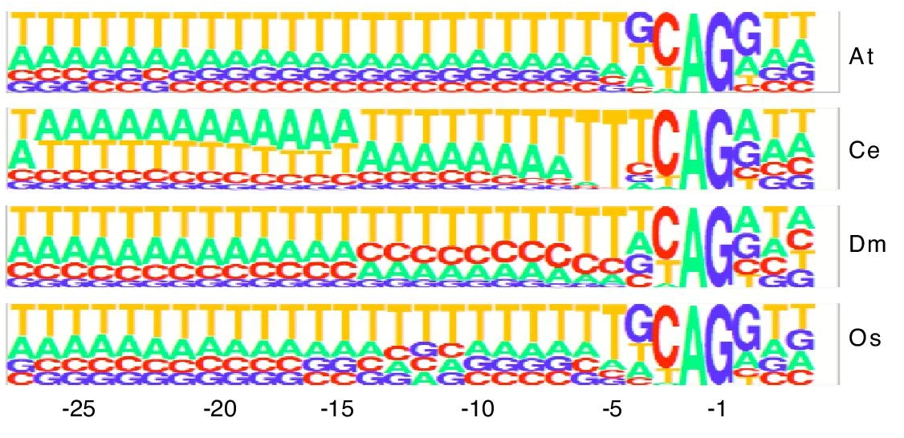
Splice site patterns
Donor (GT)
Acceptor (AG)

Slide 4
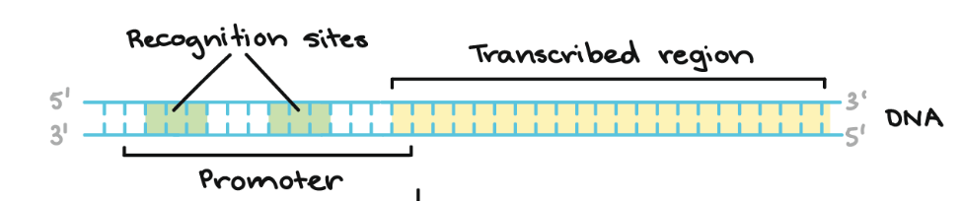
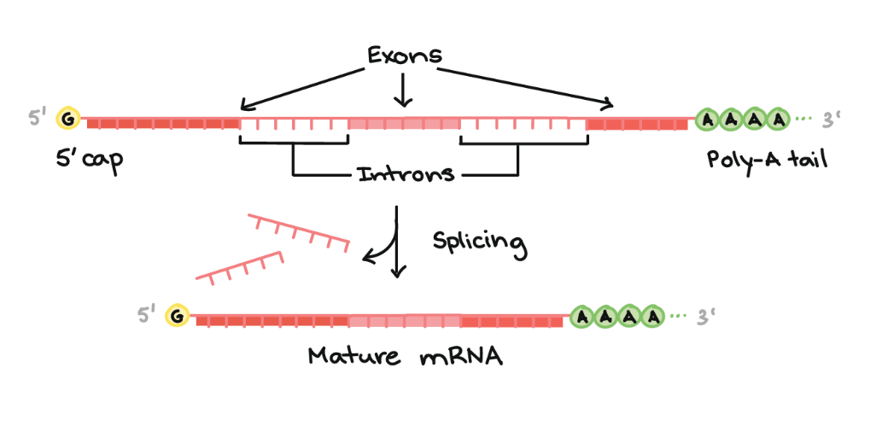
What goes wrong in transcription and translation
Biochemical processes are not exact
RNA polymerase recognizes promoter sites imperfectly
More than 50% of the distinct transcripts are produced in error -- “transcriptional noise”
Small portion of overall transcripts
Generally expressed at a low level
Never coding, recycled in cytoplasm
Introns are sometimes spliced imperfecty
This is called intron retention
Splicing errors
Image credit: Khan Academy

Slide 5
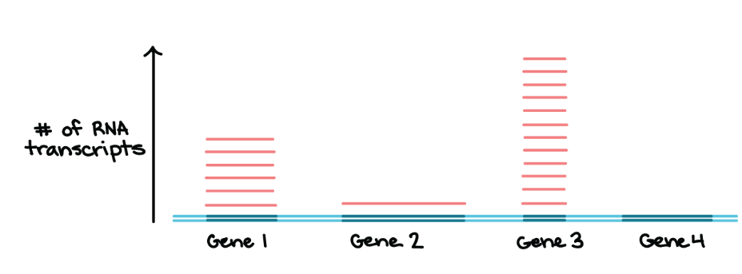
Transcription levels
Transcription levels vary a lot for individual genes
Image credit: Khan Academy

Slide 6
Transcript
Transcripts are sequences of exons after the introns are spliced out: genome exon1 exon2 exon3 transcript exon1 exon2 exon3
UTRs are UnTRanslated sequences before and after the protein coding region
Protein CoDing Sequence (CDS) starts with a start codon (ATG) and ends with a stop (TAG, TAA, or TGA) for eukaryotic genomes
ATG…
…TAA
3’ UTR
3’ UTR
5’ UTR
ATG…
…TAA
3’ UTR
3’ UTR

Slide 7
Gene
Gene is a locus on the genome containing one or more transcripts
Multiple transcripts per gene are possible due to alternative splicing
Gene starts at the start of the leftmost transcript and ends at the end of the rightmost transcript. All transcripts in a gene are on the same strand
Gene 1
intron1
intron2
exon1
GT
AG
exon2
GT
AG
exon3
Transcript 1
intron3
exon1
GT
AG
exon4
Transcript 2

Slide 8
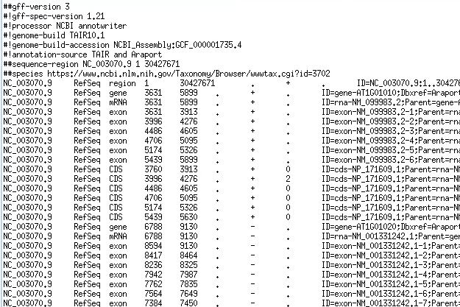
GFF/GTF files provide a map for all known genome features
Column | Description
Seqname | Name of chromosome, scaffold or contig
Source | Name of the data source
Feature | Feature type (e.g. gene, exon, transcript, CDS, five_prime_UTR)
Start | Start position of the feature
End | End position of the feature
Empty | ‘.’
Strand | Defined as + (forward) or - (reverse)
Frame | Either ‘0’, ‘1’, or ‘2’ - indicating reading frame by base position
Attribute | A semicolon separated list of other info about the feature

Slide 9
Gene representation
gene
transcript or mRNA
…
transcript or mRNA
exon
exon
exon
exon
exon
5’ UTR
5’ UTR
5’UTR
CDS
CDS
CDS
3’ UTR
Start codon (ATG)
Stop codon (TAA,TAG,TGA)

Slide 10
GTF vs GFF
There are many versions of GFF/GTF, the two most popular are:
GTF2 (Gene Transfer Format): http://mblab.wustl.edu/GTF22.html
GFF3 (Generic Feature Format): https://github.com/The-Sequence-Ontology/Specifications/blob/master/gff3.md

Slide 11
Similarities and differences between GTF and GFF files
SIMILAR: 9 columns tab-separated; Attribute (9th column) are semicolon-separated; coordinates are 1-based
GTF2 (Gene Transfer Format ):
“Feature” must contain "CDS", ”exon”, "start_codon", "stop_codon“; optional “5UTR”, “3UTR”, “transcript”
Attributes must contain space-separated gene_id “value”; transcript_id “value”; separated by semicolons
GFF3 (Generic Feature Format):
Transcript typically has “mRNA” feature, feature list is not strict
Attributes must be “=“-separated tag=value; separated by semicolons, any “=“ or “;” in the values must be escaped as %3D and %3B (hex value preceded by %)
Tags:
ID – required for features that have children, or those that span multiple lines
Name – display name
Alias – secondary name
Parent – parent of a feature
Note – free text note

Slide 12
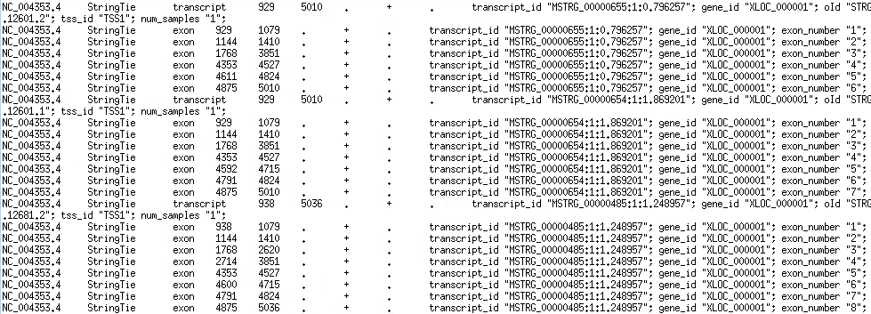
Example GTF file

Slide 13
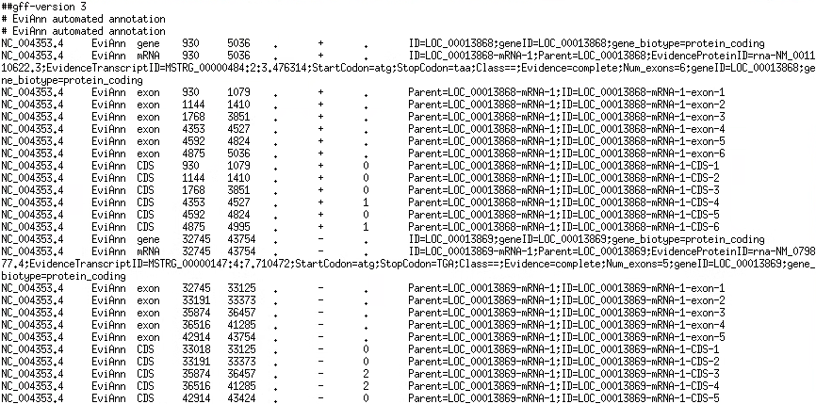
Example GFF file

Slide 14
Parsing GTF/GFF files
Split by ‘\t’ (tab)
GTF attributes field[8]: use pattern matching to extract values:
Values are: tag "value"; space separated
Perl: =~ /transcript_id "(\S+)";/
Python: re.search(r'transcript_id\s+"([^"]+)"', line)
GFF attributes field[8]: have to split
Values are: tag=value; no spaces no ";" or "=" in values or tags
Split at ";", then split at "="

Slide 15
GTF/GFF frame
Frame is field 8
Only used for CDS records
Values:
0 means that the first base of the feature is the first base of a codon
1 means that the second base is the first base of a codon
2 means that the third base is the first base of a codon
5’ UTR
ATG… AG
G …TAA
3’ UTR
3’ UTR
GCGAGGACT…
AGCGAGGACT…
TAGCGAGGACT…

Slide 16
How transcripts are obtained
Two methods
Ribosome depletion (ribo-zero)
Poly-A capture
Dominant method is Poly-A capture (EST, RNA-Seq, Iso-Seq, ONT sequencing)
Reads mature transcripts with introns spliced out
Requires fresh good quality RNA
Good for transcriptome assembly
Ribo-zero can be used for degraded RNA
Maybe OK for quantification
Bad for transcriptome assembly

Slide 17
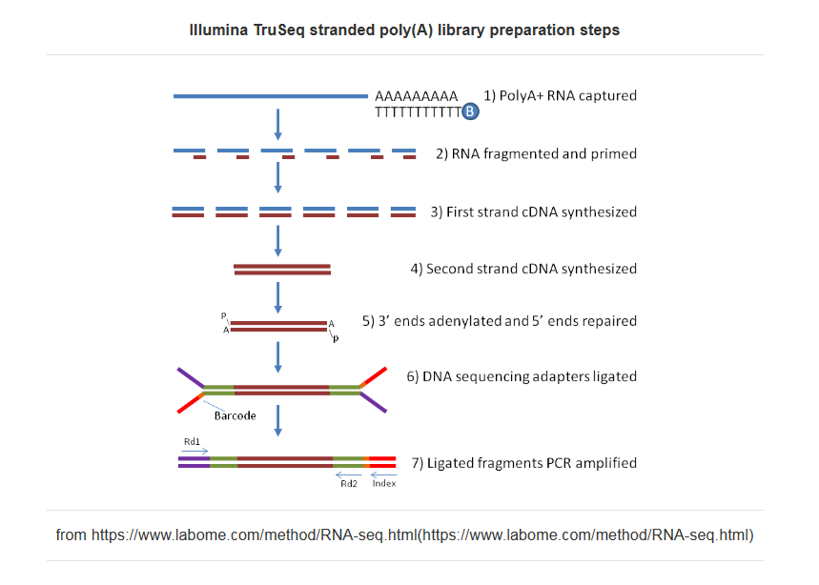
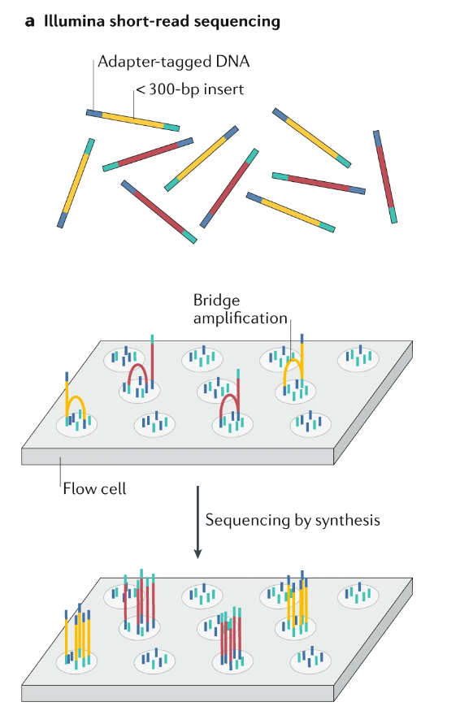
Short read Illumina RNA-seq
and Logsdon GA, Vollger MR, Eichler EE. Long-read human genome sequencing and its applications. Nature Reviews Genetics. 2020 Oct;21(10):597-614.

Slide 18
Long read RNA sequencing
Long read technologies can capture entire transcripts
They work well for transcript assembly and quantification
PacBio “IsoSeq” or “Kinnex” protocols
Kinnex provides comparable cost per GB (~$10) compared to Illumina RNA-seq
https://youtu.be/NICUp8C6rms
Oxford Nanopore cDNA or direct RNA sequencing
Still high error rates (5-7%)

Slide 19
Uses of transcriptome sequencing
Transcript assembly
Can help figure out which genome sequences are transcribed, locate exons/introns
Use transcripts for genome annotation
Transcript quantification
Figure out which transcripts are expressed
Could be very different in different tissues, under different conditions

Slide 20
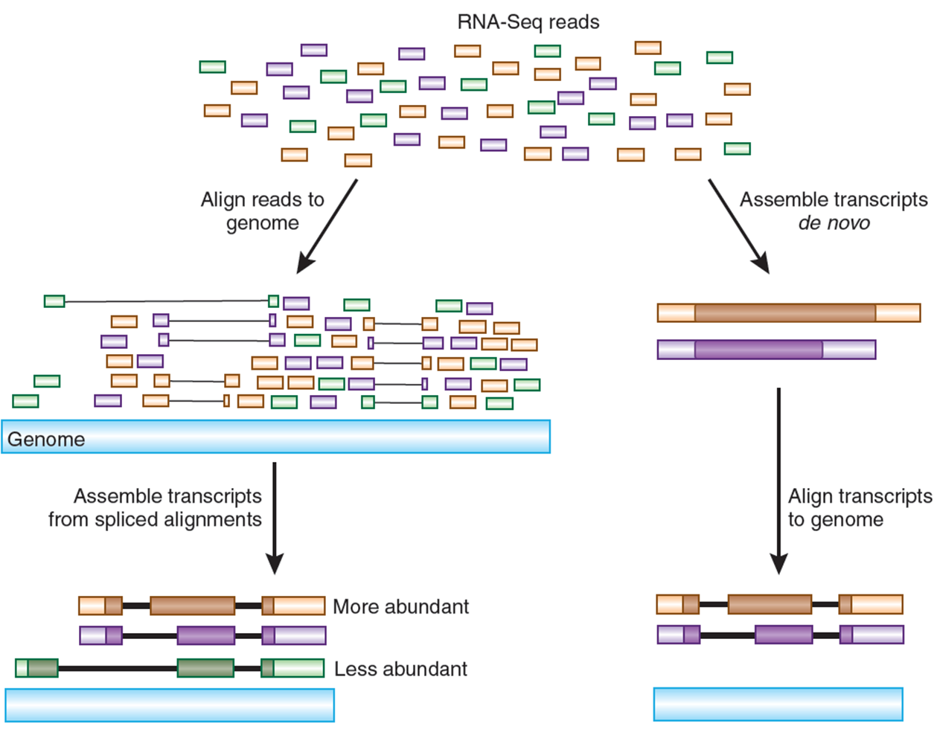
Transcriptome assembly
Stored in a
GFF/GTF file
Figure from: Haas, B. J. & Zody, M. C. Nature Biotech. 28, 421–423 (2010)

Slide 21
De novo transcript assembly
Similar to genome (contig) assembly
Obstacles:
Highly uneven coverage of different transcripts and along a transcript
Gaps in transcript coverage and repeats?
We do not know where the splice sites are!
Alternative splicing:
I do not recommend doing this unless there is no genome available

Slide 22
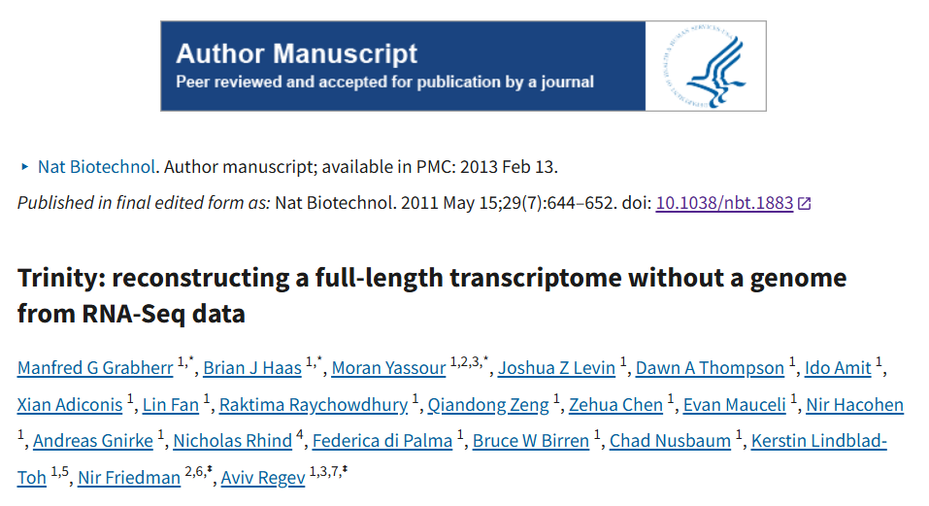
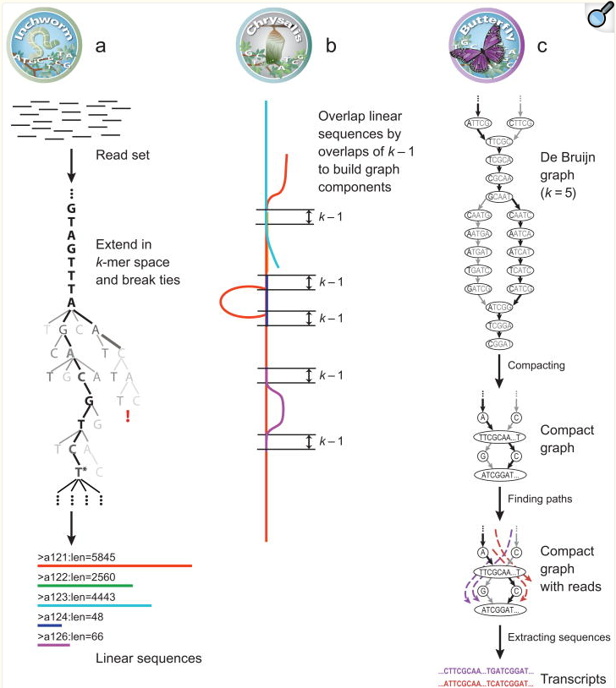
De novo transcript assemblers
Short-read: Trinity, based on DeBruijn graph

Slide 23
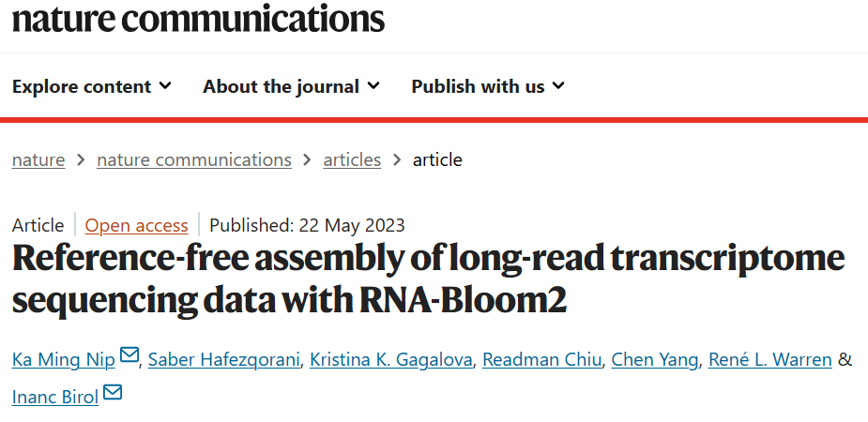
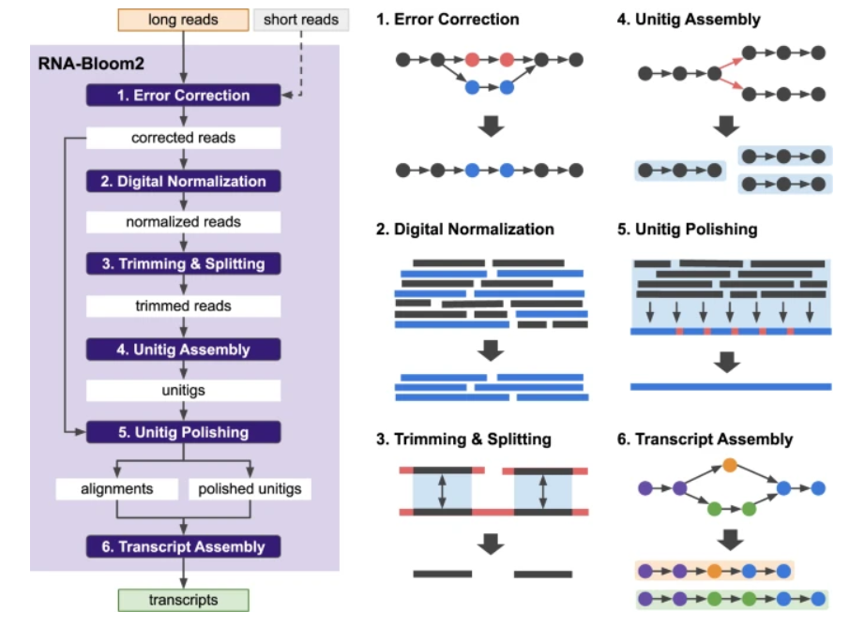
De novo transcript assemblers
Long read: RNA-Bloom2

Slide 24
Spliced alignment
We can (more reliably) find transcripts on the genome by spliced alignment of transcriptome reads
Spliced alignment is gapped alignment with specific sequence patterns around gaps
Transcriptome read
AAAAAAA
Forward or “+” strand alignment
Genome
GT AG
exon
exon
AAAAAAA
Reverse or “-” strand alignment
Genome
CT AC
exon
exon

Slide 25
Spliced alignment
We expect GT-AG (CT-AC) canonical splice sites
Other combinations are possible (GC-AG or AT-AC)
Un-spliced aligned reads – strand unknown
Transcriptome read
AAAAAAA
Forward or “+” strand alignment
Genome
GT AG
exon
exon
AAAAAAA
Reverse or “-” strand alignment
Genome
CT AC
exon
exon

Slide 26
Spliced alignment programs
Illumina RNA-seq reads
STAR
HISAT2
Long reads (PacBio or ONT):
Minimap2
Spliced alignments sometimes produce errors/miss splice sites
“anchors” may be short
AGATAA|(GT)……………(AG)|GT or AGATAAGT ?
Non-canonical splice sites can be off
Errors in Oxford Nanopore Technologies reads (especially indels) can lead to imprecise splice site detection

Slide 27
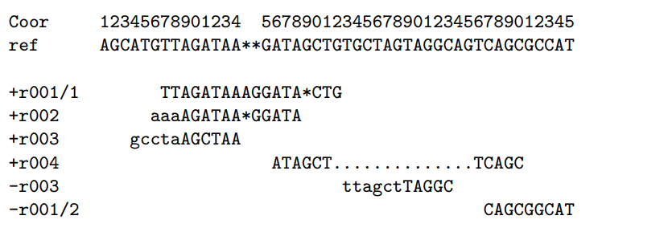
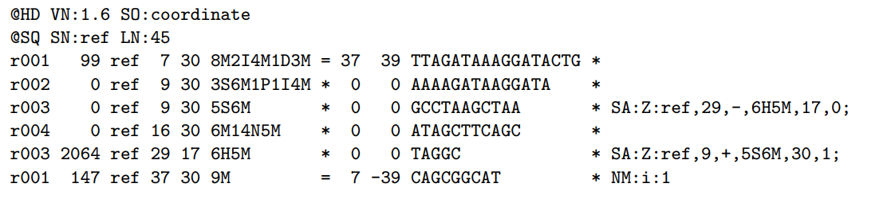
SAM format for spliced alignment
Examples of CIGAR strings

